Slide 1
Application of General Adversarial Networks in Smoothing Handwriting
CAP Stone SMU Data Science Fall 2020, Project Outline
Muchigi Kimari, Edward Fry, Ikenna Nwaogu, YuMei Bennett
Master of Science in Data Science, Southern Methodist University,
Dallas, TX 75275 USA

Slide 2
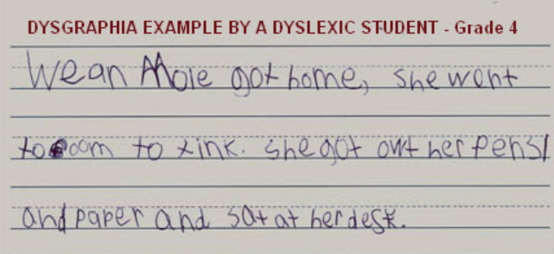
Dysgraphia Is A Learning Disability
Dysgraphia is a learning disability that affects writing.
It requires a complex set of a motor and information processing skills.
Dysgraphia makes it hard for students to write.
​Students can have a poor spelling abilities, bad handwriting.
​And trouble putting thoughts onto paper.

Slide 3
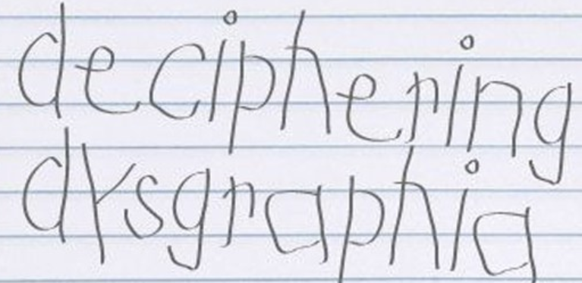
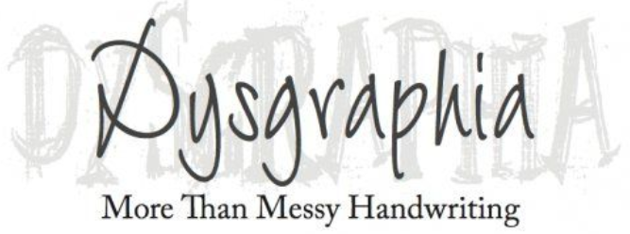
Machine Learning Can Help
Dysgraphia people often show extradentary ability in other areas.
Trouble in handwriting can hinder their ability to communicate effectively.
The project objective is to create a ML program to auto-correct dysgraphia handwriting.
GANS will be able to take dysgraphia handwriting from a document and present it in a better realistic handwritten text.

Slide 4
Methods And Tools
Generative Adversarial Network (GAN)
  Two neural networks compete
  Could merge samples
Style Transfer
  Famous example of applying artist style to photos
  Would be used to merge samples
Auto Encoder
  Similar to principal components analysis (PCA)
  More aggressive dimensional reduction
Singular Value Decomposition (SVD)
  Linear algebra method
  Sometimes helpful with image manipulation
Recurrent Neural Network (RNN)
  Known applications in handwriting recognition
  More difficult than GAN; will explore only as a backup option
  Distributed computing
DASK Or Spark
  Distributed Computing
  Choose one to use

Slide 5
Data Source
Expected Results
MNIST – collection of handwritten digits in image format
UCI Machine Learning Repository - Letter Recognition Data Set
Chars74K dataset - Character Recognition in Natural Images
Data Augmentation – technique to expand existing datasets if needed
Demonstrate effectiveness of handwriting smoothing
Identify performant models
Produce a Python package other developers can use
Release a command line utility any one can use to smooth handwriting

